Slide 1
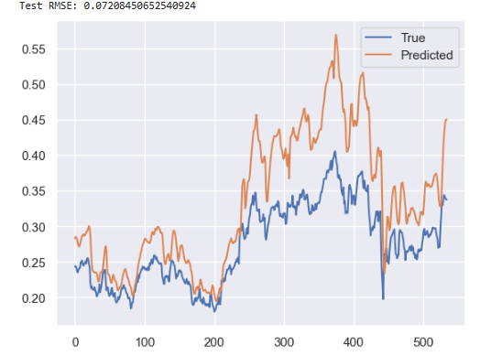
deep learning prediction and true value

Slide 2
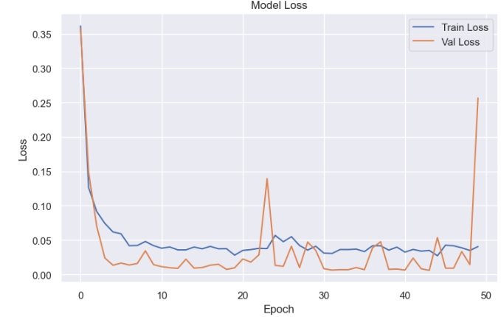

Slide 3
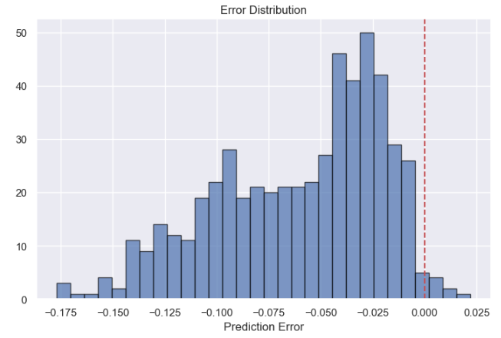

Slide 4
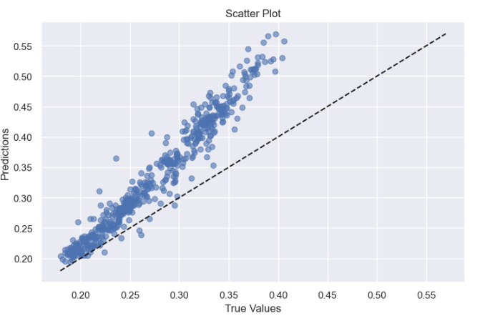

Slide 5
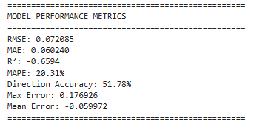

Slide 6
Assumptions:
Market patterns are somewhat predictable and repeatable
The chosen features contain sufficient predictive information
The relationship between past and future prices is learnable
The training data distribution represents future market conditions
Major Risks:
Black swan events completely break the model
Structural breaks in market behavior make past patterns irrelevant
Overfitting leads to false confidence in historical patterns
Model decay occurs as market dynamics evolve
Exogenous factors (news, policies, sentiment) are not captured

Slide 7
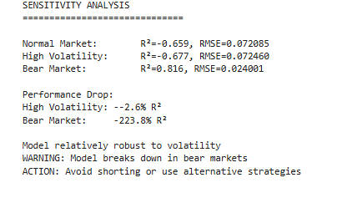

Slide 8
If the business has a high tolerance for error, this model can be directly used to assist decision-making.
The model can serve as a basic reference but should not be relied upon entirely, especially in highly volatile or high-risk scenarios.
It is not suitable for trading or strategic decision-making, as incorrect direction predictions could lead to direct losses.
In risk-sensitive contexts, the impact of extreme errors must be carefully monitored.

